Slide 1
SDN in Docker
Team :
Pranita Hatte
Sanjana Hunasamaranahalli Dayananda Kumar
Vaibhavi Vinay Moghe
Gokul Surendra

Slide 2
Contents
Introduction to docker
OpenvSwitch & Opendaylight
Docker configuration
Mixup
Screenshots

Slide 3
What is Docker ?
Docker is an open source project that automates the deployment of application inside container
Docker is self-contained sealed unit of software which is carved from operating system.
It contains everything needed to run a code – dependencies, process, networking, configs, part of OS needed to run a code

Slide 4
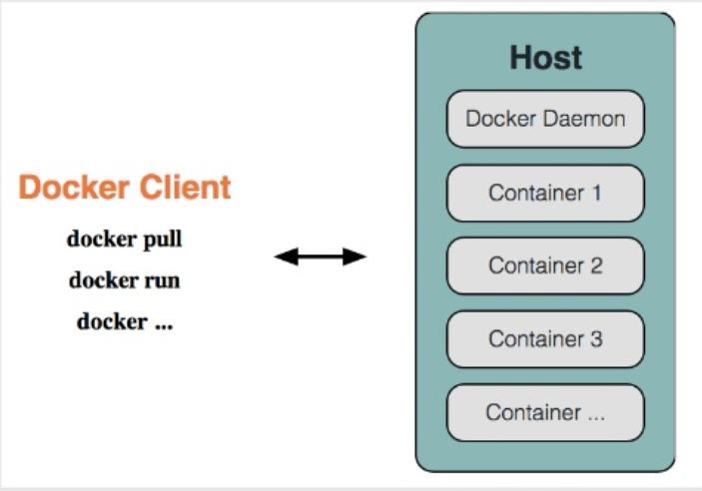
Docker Architecture

Slide 5
Why Docker?
Isolation
Lightweight
Simplicity
Workflow
Community

Slide 6
OpenVSwitch- What?
With Server Virtualization need for access layer connecting to virtual switch
rather than physical switch was sensed.
Virtual Switch – Software layer that resides in servers hosting VMs
VMs in the form of Docker containers
Have logical ports
Logical ports connect to Virtual switch
OpenVSwitch (OVS) – popular virtual switch

Slide 7
OpenVSwitch – Why?
Ties multiple VMs together within a hypervisor instance on server together
For all VMs, acts as first entry point for sending traffic on the network
Main Advantage – Does not have a native SDN Controller. OVS can be
managed and controlled by any third party controller or manager.
Example: OpenDaylight as used here
Thus, OpenDaylight controls OVS

Slide 8
OpenDaylight
ODL is modular, pluggable and flexible controller platform
Implemented in software and contained in its own JVM
Can be deployed on any hardware platform or OS that supports Java
Capable of performing series of base network services,
example: what devices are in what network, their capabilities,
statistics gathering
Striking feature of ODL: Controller is used to collect network information,
run algorithms, perform analysis and based on this create rules running
throughout the network.

Slide 9
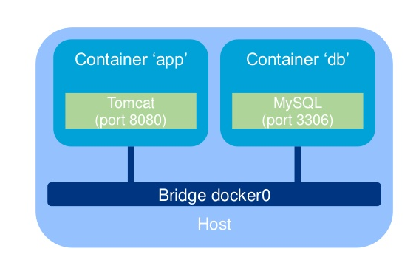
Isolation by Design - Docker
Natively, each container runs isolated from the outside world
A bridge network(an internal, virtual switch) is provided with Docker
but does not allow containerized processes to communicate together
without further config

Slide 10
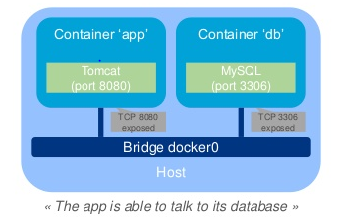
Exposing Ports
Exposing ports allows containers services to talk together through the bridge network
Dockerfile : add line “EXPOSE <port>”( several ports can be appended)
Command line switch: “docker run …-expose <port>
Example for the ‘app’ container: “docker run … -expose 8080”

Slide 11
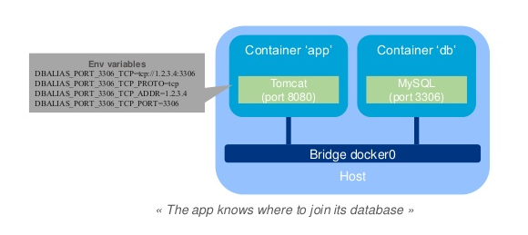
Linking Containers
Linking enables a client container to get information related to a resource container(also known as the linked container)
Command line switch: “docker run –link <containername:alias>”
Example on ‘app’ container: “docker –run …-link db:dbalias”

Slide 12
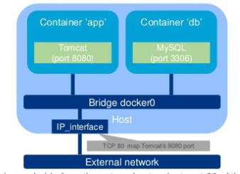
Mapping ports
Mapping ports enable to publish container’s ports on “external interfaces.
Ports maybe translated
Command line switch: “docker run –p <externalport : insideport>”
Example for ‘app’ container: “docker –run … -p 80:8080”

Slide 13
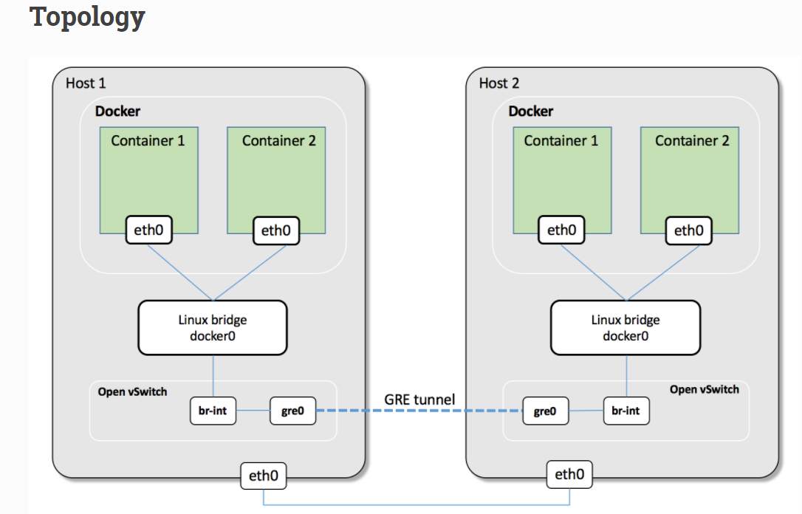

Slide 14
Challenges Faced:
Understanding networking in docker.
Installation of opendaylight on docker because of
dependency issues.
Configuring tunnel connection between two hosts.

Slide 15
Future Scope:
Create a new docker network instead of using default docker0 bridge.
Configure cluster of opendaylight instances where each
hosted on docker containers.

Slide 16
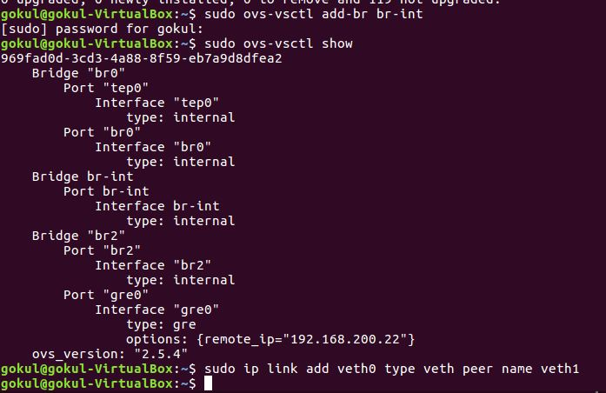
Screen Shots:
OVS bridge

Slide 17
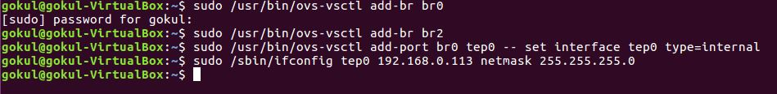
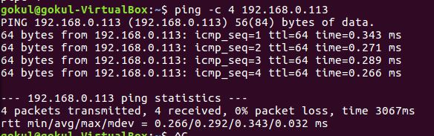
Bridge on Host 1
Bridge on Host 2

Slide 18
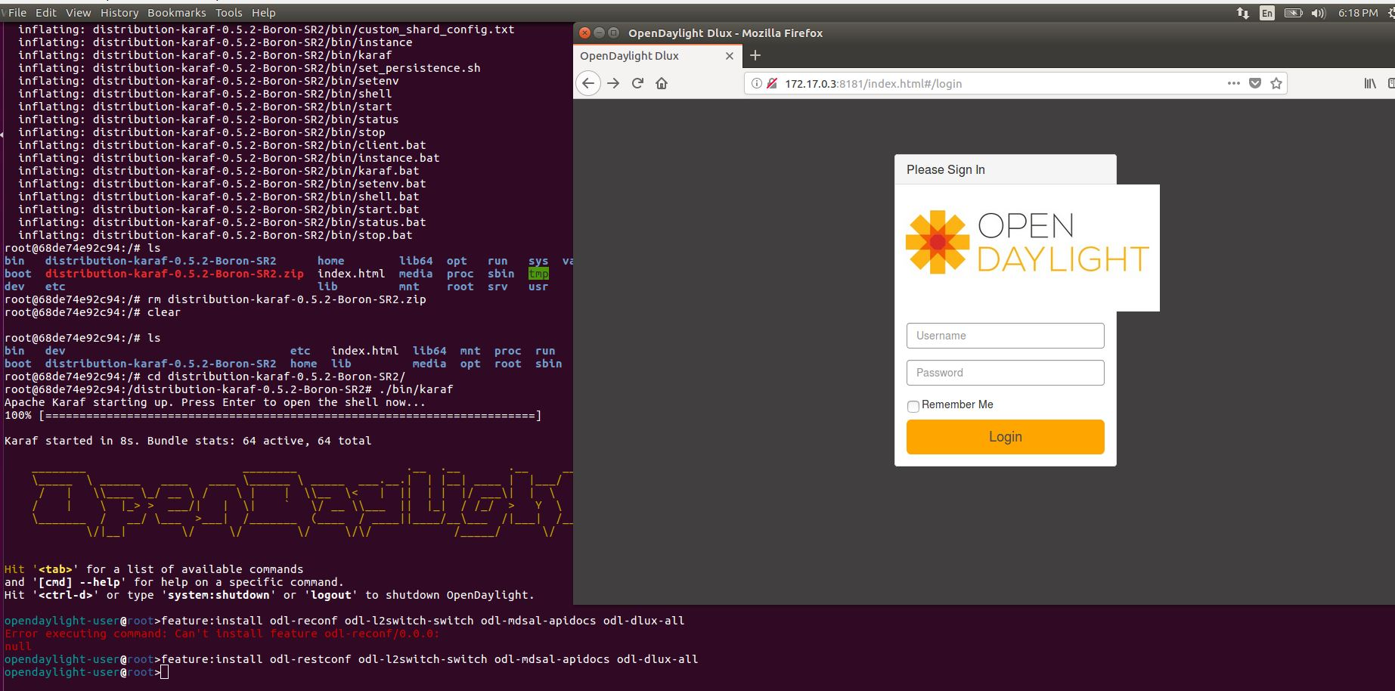
ODL on Docker

Slide 19
END

